Slide 1
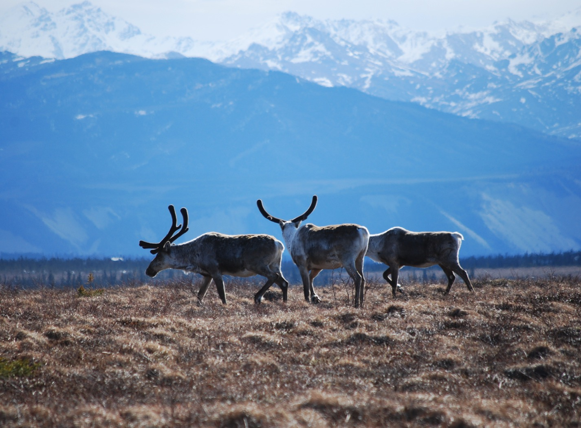
Arctic Boreal Vulnerability Experiment (ABoVE)
2017 ABoVE Airborne Campaign
6 July 2017 (DOY 188)
AVIRIS-NG: Southeast Alaska
Charles Miller, Deputy Science Lead
Jet Propulsion Laboratory, California Institute of Technology
and the ABoVE Science Team
For Hank Margolis, Eric Kasichke, Bruce Tagg
NASA HQ
2017

Slide 2

6 July 2017/DOY 187
Southeast Alaska
Daily Status:
AVIRIS-NG / Dynamic Aviation B-200 (N53W)
REPORT DATE: 6 July 2017
Current Status of Aircraft: Yellow
Current Status of AVIRIS: GREEN
Current Deployment Location: Fairbanks AK (PAFA)
Crew: Rogers, Heidt, Nolte, Bernas
Science Coordinator: A Thorpe
Science Lead: C Miller
Project Managers: M Eastwood, I McCubbin
Instrument PI: R Green
Notes:
Aircraft avionics package continues to have intermittent loss of heading problems

Slide 3
7 July 2017/DOY 188
72-Hour Look Ahead
All plans weather dependent
Friday 7 July 2017 (DOY 188):
Seward Peninsula/YK Delta
Saturday 8 July 2017 (DOY 189):
Fort Yukon
Sunday 9 July 2017 (DOY 190):
Barrow/North Slope

Slide 4
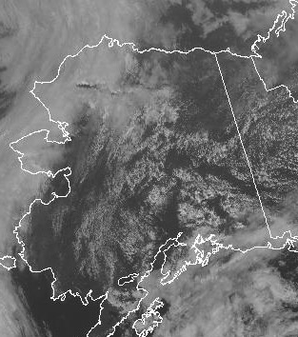
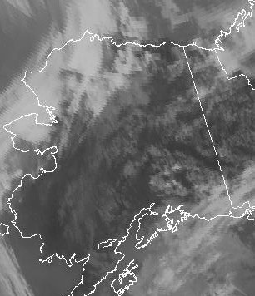
6 July 2017/DOY 187
Southeast Alaska
GOES-West Vis 2230Z
GOES-West IR 2230Z
Notes:
A strip of clear skies through the Delta Junction – Tok – Northway valley in SE Alaska

Slide 5
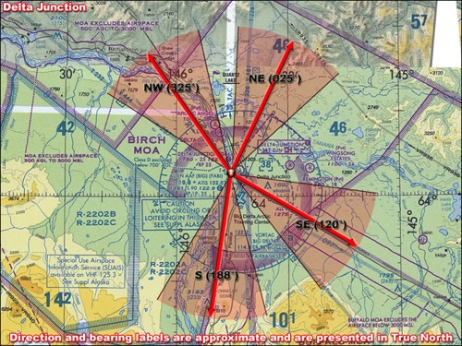
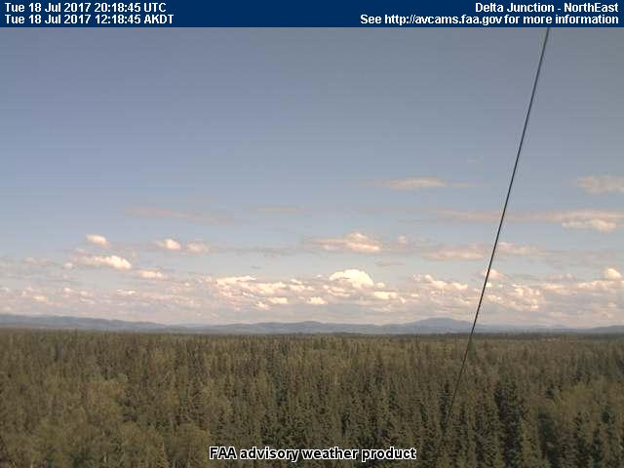
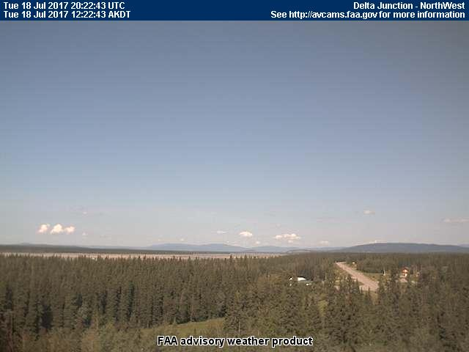
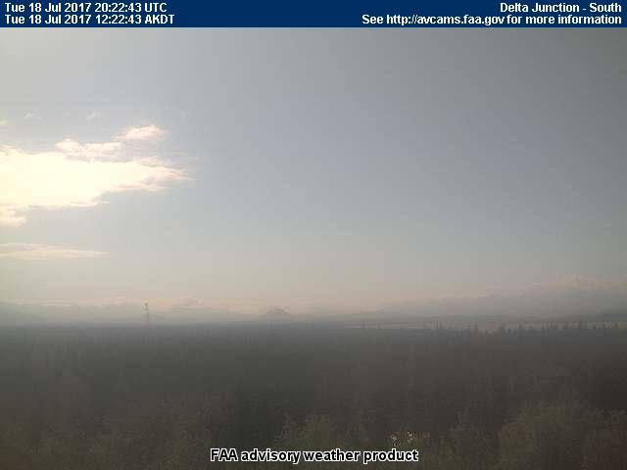
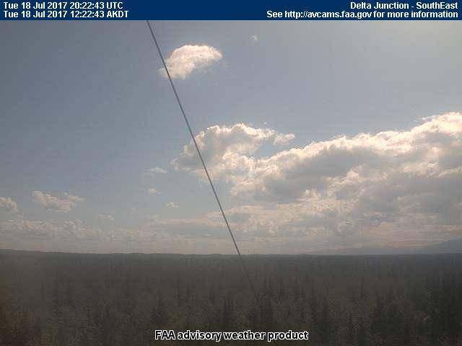
6 July 2017/DOY 187
Southeast Alaska
Delta Junction
NORTH
Northeast
Northwest
South
Southeast
Notes:
Sortie #1: AVCAM sky pictures from Chalkyitsik showing open to partly cloudy skies and little smoke to the north and east (Old Crow), clear skies west and some high level cirrues to the SW
See http://avcams.faa.gov/ for an interactive map of Alaska aviation cameras

Slide 6
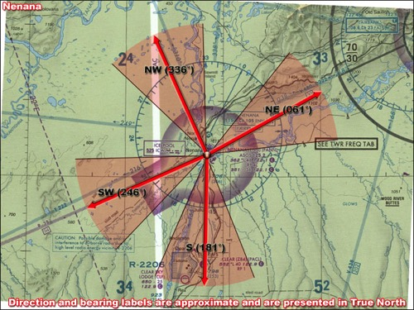
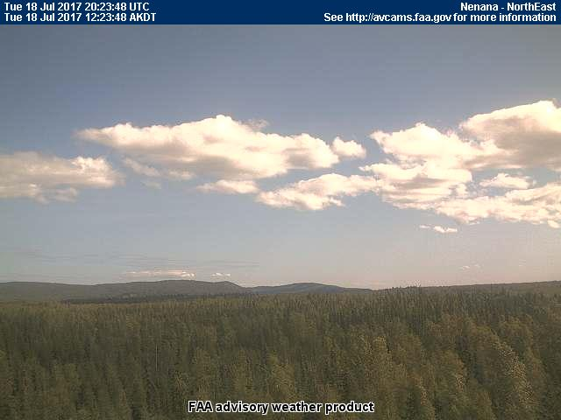
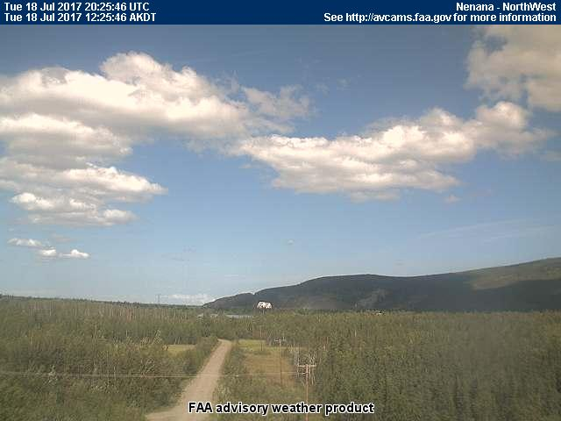
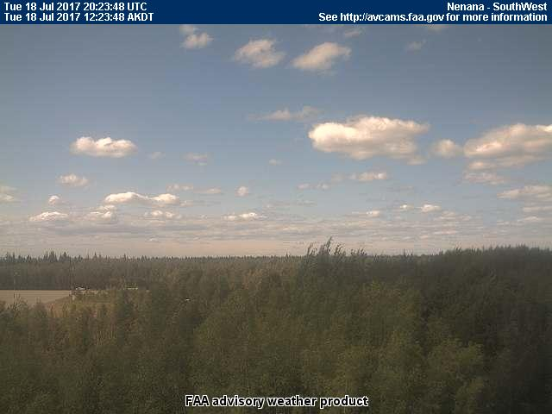
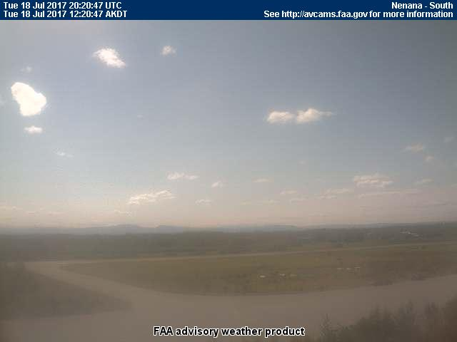
6 July 2017/DOY 187
Southeast Alaska
Nenana
NORTH
Northeast
Northwest
Southwest
South
Notes:
Sortie #1: AVCAM sky pictures from Chalkyitsik showing open to partly cloudy skies and little smoke to the north and east (Old Crow), clear skies west and some high level cirrues to the SW
See http://avcams.faa.gov/ for an interactive map of Alaska aviation cameras

Slide 7
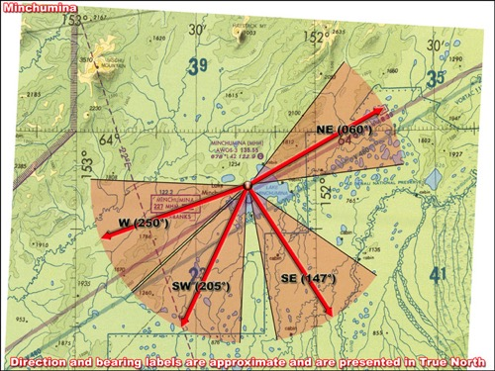
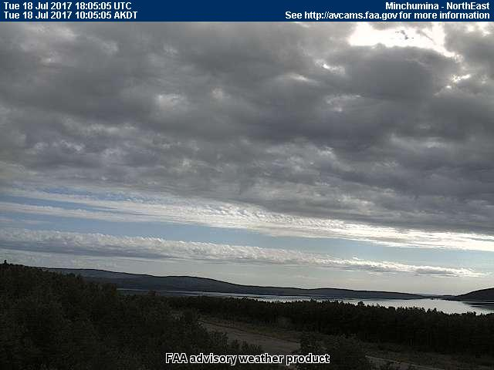
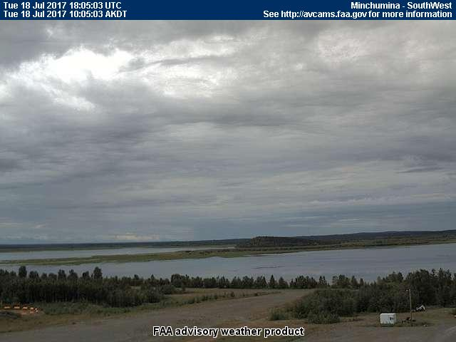
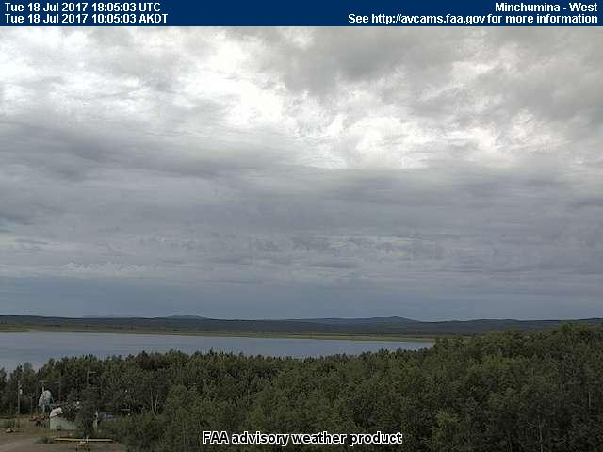
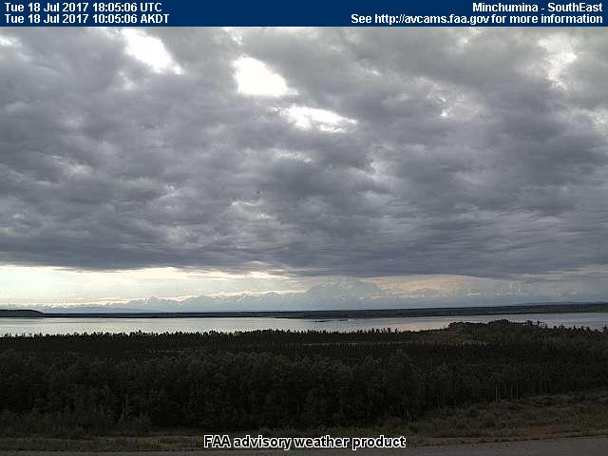
6 July 2017/DOY 187
Southeast Alaska
Minchumina
NORTH
Northeast
West
Southwest
Southeast
Notes:
Sortie #1: AVCAM sky pictures from Chalkyitsik showing open to partly cloudy skies and little smoke to the north and east (Old Crow), clear skies west and some high level cirrues to the SW
See http://avcams.faa.gov/ for an interactive map of Alaska aviation cameras

Slide 8
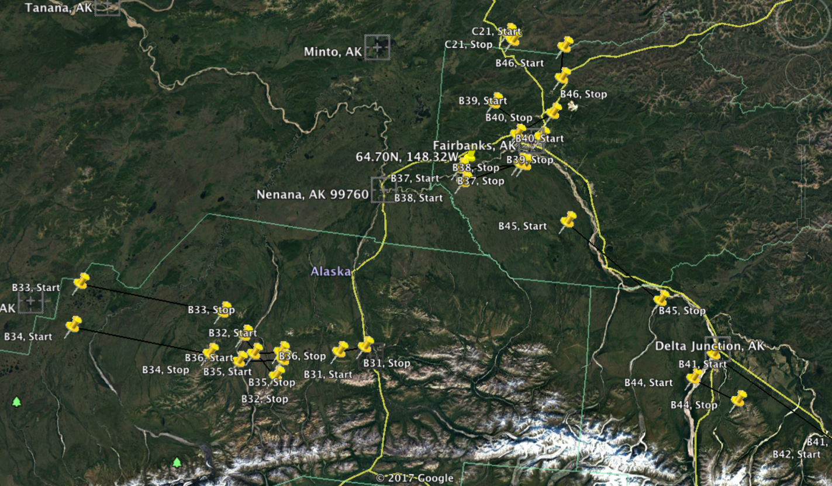
6 July 2017/DOY 187
Southeast Alaska
Planned flight lines & acquisition segments

Slide 9
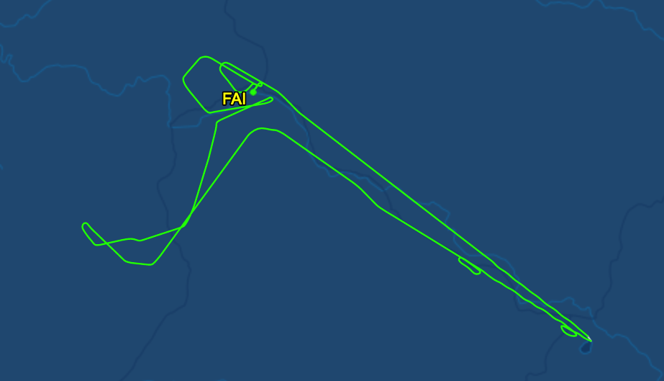
6 July 2017/DOY 187
Southeast Alaska
As-flown lines
B39
B37-38
Bonus
B45
B41
Bonus
B32
B36
B42
B31
Bonus
B43

Slide 10
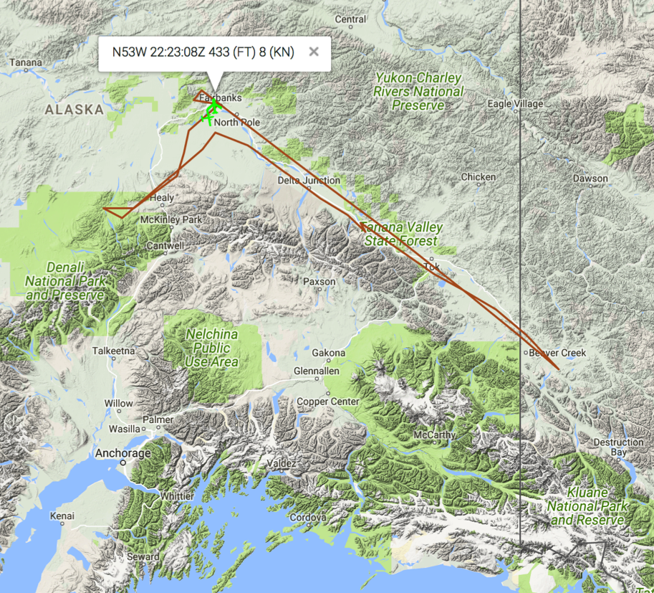
6 July 2017/DOY 187
Southeast Alaska
As-flown flight lines

Slide 11
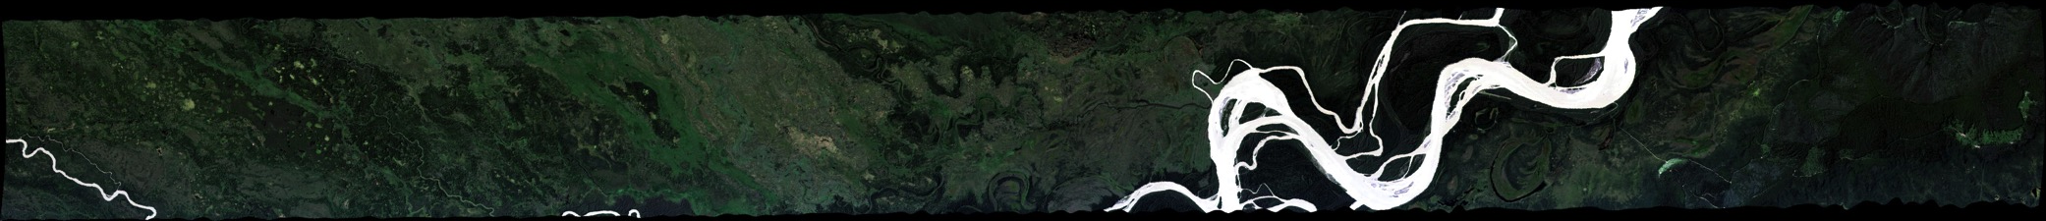
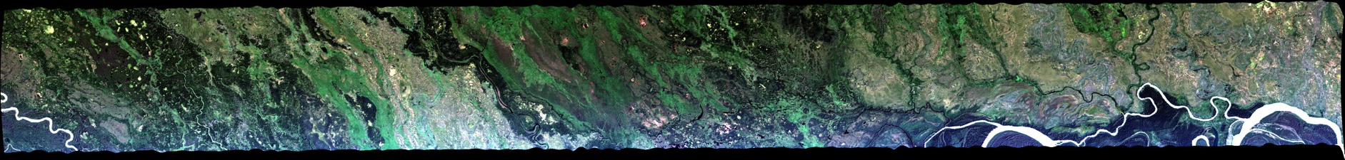
6 July 2017/DOY 187
Southeast Alaska
Winston Olson-Duvall, JPL
AVIRIS-NG Quick-look products
https://avirisng.jpl.nasa.gov/cgi/flights.cgi?step=view_flightlog&flight_id=ang20170706t
A. Line B37, Track Air #115, Run ID 180635: Bonanza Creek LTER
B. Line B38, Track Air #116, Run ID 181605: CRREL Tanana River fire scar
A
B
A. Imaging of the hills on the eastern boundary of the Innoko NWR
B. Coastal mountains separating Anvik from St Mary’s

Slide 12
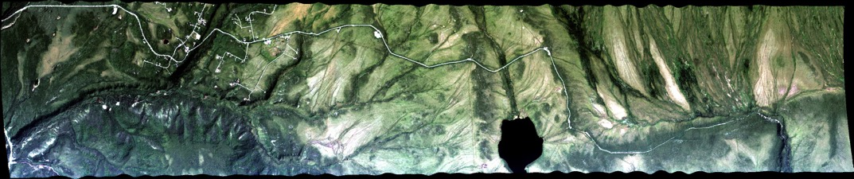
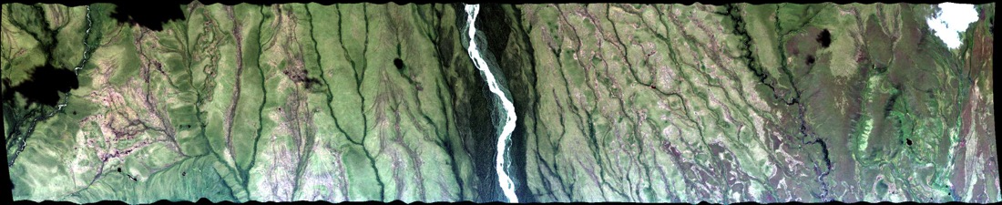
6 July 2017/DOY 187
Southeast Alaska
Winston Olson-Duvall, JPL
AVIRIS-NG Quick-look products
https://avirisng.jpl.nasa.gov/cgi/flights.cgi?step=view_flightlog&flight_id=ang20170706t
A. Line B31, Track Air #109, Run ID 183519: NEON Healy box
B. Line B36, Track Air #114, Run ID 184209: Denali National Park
A
B
A. NEON intensive airborne observations & flux tower in this swath
B. Overflight of Denali National Park long-term monitoring sites

Slide 13
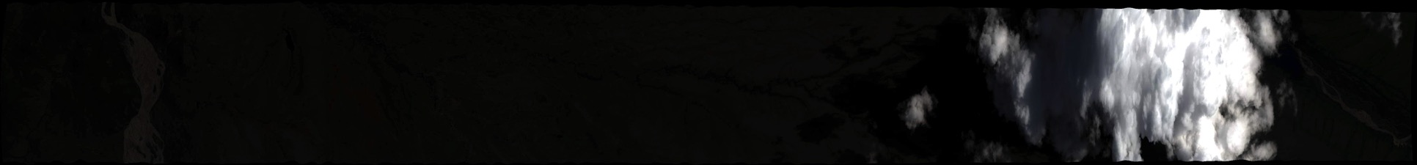
6 July 2017/DOY 187
Southeast Alaska
Winston Olson-Duvall, JPL
AVIRIS-NG Quick-look products
https://avirisng.jpl.nasa.gov/cgi/flights.cgi?step=view_flightlog&flight_id=ang20170706t
A. Line B32, Track Air #110, Run ID 185049: Denali National Park
B. Line B45, Track Air #123, Run ID 192052: Eilson AFB
A
B
A. Denali National Park long-term monitoring sites; large clouds @ end
B. The braided Tanana River dominates the middle and end of this image

Slide 14
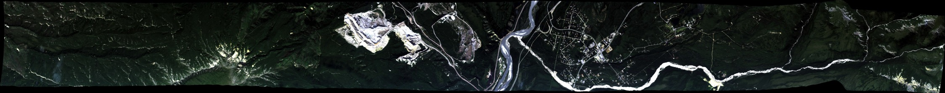
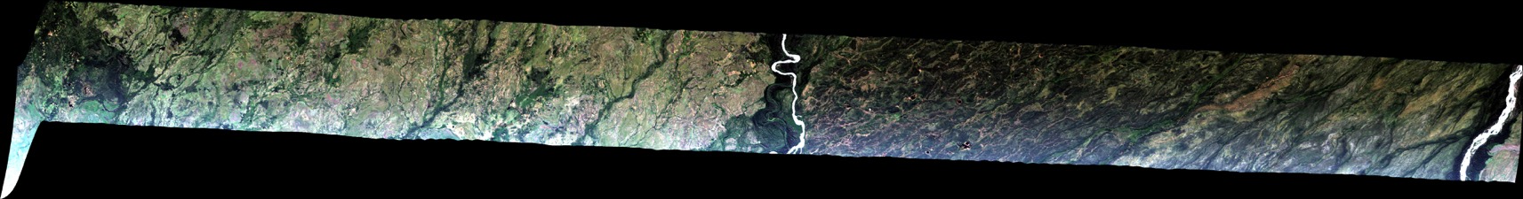
6 July 2017/DOY 187
Southeast Alaska
Winston Olson-Duvall, JPL
AVIRIS-NG Quick-look products
https://avirisng.jpl.nasa.gov/cgi/flights.cgi?step=view_flightlog&flight_id=ang20170706t
A. Bonus Line, Run ID 190214: SE Alaska
B. Bonus Line, Run ID 191053: SE Alaska
A
B
A. Healy? Delta Junction?
B. TBD

Slide 15
6 July 2017/DOY 187
Southeast Alaska
Winston Olson-Duvall, JPL
AVIRIS-NG Quick-look products
https://avirisng.jpl.nasa.gov/cgi/flights.cgi?step=view_flightlog&flight_id=ang20170706t
A. Line B41, Track Air #119, Run ID 193608: Delta Junction transect 1 of 3
B. Line B42, Track Air #120, Run ID 195616: Delta Junction transect 2 of 3
A
B
A. Allen Airfield @ beginning, agricultural fields @ middle and end
B. The braided Tanana River dominates the middle and end of this image

Slide 16
6 July 2017/DOY 187
Southeast Alaska
Winston Olson-Duvall, JPL
AVIRIS-NG Quick-look products
https://avirisng.jpl.nasa.gov/cgi/flights.cgi?step=view_flightlog&flight_id=ang20170706t
A. Line B43, Track Air #121, Run ID 193608: Delta Junction transect 3 of 3
B. Bonus Line, Run ID 21717: SE Alaska/NW YT
A
B
A. Notable transition from forest to wetlands
B. The braided Tanana River dominates the middle and end of this image

Slide 17
6 July 2017/DOY 187
Southeast Alaska
Winston Olson-Duvall, JPL
AVIRIS-NG Quick-look products
https://avirisng.jpl.nasa.gov/cgi/flights.cgi?step=view_flightlog&flight_id=ang20170706t
A. Bonus Line, Run ID 211917: SE Alaska
B. Bonus Line, Run ID 214051: SE Alaska
A
B
A. Notable transition from forest to wetlands
B. The braided Tanana River dominates the middle and end of this image

Slide 18
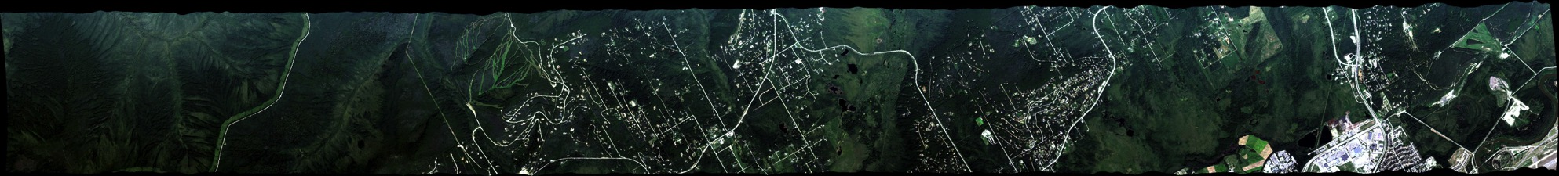
6 July 2017/DOY 187
Southeast Alaska
Winston Olson-Duvall, JPL
AVIRIS-NG Quick-look products
https://avirisng.jpl.nasa.gov/cgi/flights.cgi?step=view_flightlog&flight_id=ang20170706t
A. Line B39, Track Air #117, Run ID 220340: NEON CPCRW box, CRREL Goldstream PF
A
B
A. NEON flux tower, CRREL lidar transect and Fairbanks outskirts imaged in this swath

